Slide 1
Sharing in Communities – Demystified
Brian Checkoway
Collaboration Architect

Slide 2
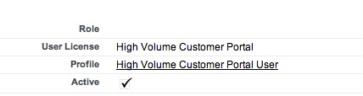
Sharing for users without roles: HVPU / Service Cloud Portal / Customer Communities licenses
These users DO NOT have roles
By default, can only see their own records (e.g. My Cases)
Sharing Sets can provide additional visibility to records
Sharing Groups allow sharing of records owned by these users to other users with roles.
Cannot use Apex sharing rules
Notes:
Swap the image with a communities, two slides, second with communities. Chatter: mobile, social, and business data. Social data—extend beyond 4 walls.
Customer companies are also connected with their partners, distributors, and suppliers so they can share customer information and better sell and service customers.
Customer companies even have connected products. By connecting your products to your employees, your customers, and social networks, you can better service your customers. You can use product data for maintenance, marketing promotions, and sales opportunities.
This is what a customer company looks like. You need to be more deeply integrated with your customers than ever before because that’s what they want, and it’s more possible and more exciting today than it ever was before.

Slide 3
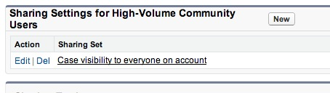
EXAMPLE 1:
Example: Share cases between contacts at the same company
Setup -> Sharing settings -> Set Cases visibility to Private
Setup -> Communities -> Settings -> Sharing Settings for HVPU
Add Sharing Set. Object = Cases. Visibility = see cases where the user's account is the same
Notes:
Swap the image with a communities, two slides, second with communities. Chatter: mobile, social, and business data. Social data—extend beyond 4 walls.
Customer companies are also connected with their partners, distributors, and suppliers so they can share customer information and better sell and service customers.
Customer companies even have connected products. By connecting your products to your employees, your customers, and social networks, you can better service your customers. You can use product data for maintenance, marketing promotions, and sales opportunities.
This is what a customer company looks like. You need to be more deeply integrated with your customers than ever before because that’s what they want, and it’s more possible and more exciting today than it ever was before.

Slide 4
EXAMPLE 2:
Example: Share cases between contacts at different companies
Setup -> Sharing settings -> Set Cases visibility to Private
Setup -> Cases -> Create Lookup Field “Relationship”, Lookup to “Contact”
Setup -> Communities -> Settings -> Sharing Settings for HVPU
Add Sharing Set. Object = Cases. Visibility = see cases where the user's account is the same as “Relationship”
Set Relationship field on Case to the Contact to whom you wish to share
Notes:
Swap the image with a communities, two slides, second with communities. Chatter: mobile, social, and business data. Social data—extend beyond 4 walls.
Customer companies are also connected with their partners, distributors, and suppliers so they can share customer information and better sell and service customers.
Customer companies even have connected products. By connecting your products to your employees, your customers, and social networks, you can better service your customers. You can use product data for maintenance, marketing promotions, and sales opportunities.
This is what a customer company looks like. You need to be more deeply integrated with your customers than ever before because that’s what they want, and it’s more possible and more exciting today than it ever was before.

Slide 5

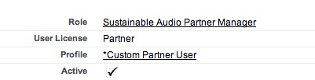

Sharing for users with roles: CPEA / Partner Portal / Partner Communities licenses
These user DO have roles
Can support more complex sharing rules
Can use Apex Sharing Rules
Notes:
Swap the image with a communities, two slides, second with communities. Chatter: mobile, social, and business data. Social data—extend beyond 4 walls.
Customer companies are also connected with their partners, distributors, and suppliers so they can share customer information and better sell and service customers.
Customer companies even have connected products. By connecting your products to your employees, your customers, and social networks, you can better service your customers. You can use product data for maintenance, marketing promotions, and sales opportunities.
This is what a customer company looks like. You need to be more deeply integrated with your customers than ever before because that’s what they want, and it’s more possible and more exciting today than it ever was before.

Slide 6
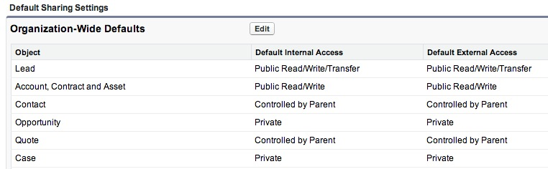
EXAMPLE: Sharing with CPEA / Partner Portal / Partner Communities licenses:
Example: Partner provides 1st tier support (Share cases logged by the customer United with the partner Acme)
Setup -> Sharing settings -> Set OWD on Cases to Private
Setup -> Sharing settings -> Sharing rule on Cases Criteria: Cases where Account ID = United, Share with Partner Role = Acme
Notes:
Swap the image with a communities, two slides, second with communities. Chatter: mobile, social, and business data. Social data—extend beyond 4 walls.
Customer companies are also connected with their partners, distributors, and suppliers so they can share customer information and better sell and service customers.
Customer companies even have connected products. By connecting your products to your employees, your customers, and social networks, you can better service your customers. You can use product data for maintenance, marketing promotions, and sales opportunities.
This is what a customer company looks like. You need to be more deeply integrated with your customers than ever before because that’s what they want, and it’s more possible and more exciting today than it ever was before.

Slide 7
User Sharing
With Summer '13, we support sharing settings on the external User object.
You can prevent users from seeing other users in the Community
Example: Customers shouldn't see any other customers
-Setup -> Sharing settings -> Uncheck Community User Visibility
This will prevent external users from seeing any other users in the community
Exceptions: Users could see posts from other users on records or groups
Note: This is an org-wide setting and will apply to all active communities
Notes:
Swap the image with a communities, two slides, second with communities. Chatter: mobile, social, and business data. Social data—extend beyond 4 walls.
Customer companies are also connected with their partners, distributors, and suppliers so they can share customer information and better sell and service customers.
Customer companies even have connected products. By connecting your products to your employees, your customers, and social networks, you can better service your customers. You can use product data for maintenance, marketing promotions, and sales opportunities.
This is what a customer company looks like. You need to be more deeply integrated with your customers than ever before because that’s what they want, and it’s more possible and more exciting today than it ever was before.

Slide 8
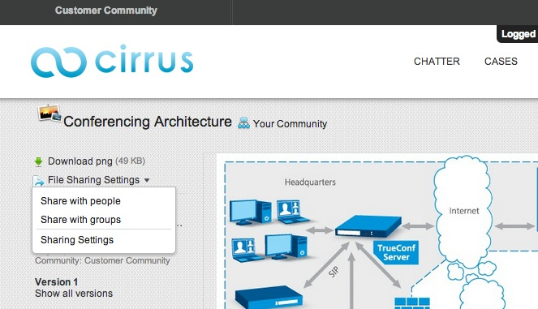
File Sharing
Chatter Files – most common scenarios
1. Users can manually share a file directly with other users
2. Users can post a file to a group. Any member of that group can view the file.
Notes:
Swap the image with a communities, two slides, second with communities. Chatter: mobile, social, and business data. Social data—extend beyond 4 walls.
Customer companies are also connected with their partners, distributors, and suppliers so they can share customer information and better sell and service customers.
Customer companies even have connected products. By connecting your products to your employees, your customers, and social networks, you can better service your customers. You can use product data for maintenance, marketing promotions, and sales opportunities.
This is what a customer company looks like. You need to be more deeply integrated with your customers than ever before because that’s what they want, and it’s more possible and more exciting today than it ever was before.

Slide 9
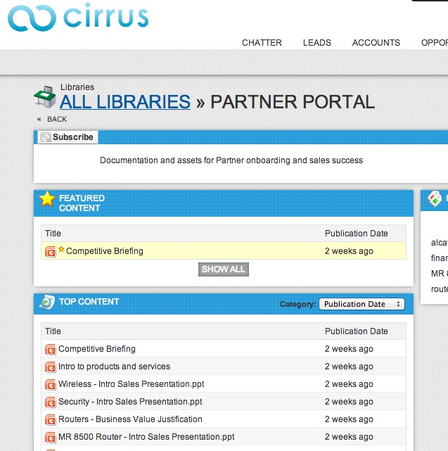
File Sharing
Content Libraries
If files are posted to a Library, only members of that Library can view the file.
You need a role to access a Content Library (Partners, CPEA)
Notes:
Swap the image with a communities, two slides, second with communities. Chatter: mobile, social, and business data. Social data—extend beyond 4 walls.
Customer companies are also connected with their partners, distributors, and suppliers so they can share customer information and better sell and service customers.
Customer companies even have connected products. By connecting your products to your employees, your customers, and social networks, you can better service your customers. You can use product data for maintenance, marketing promotions, and sales opportunities.
This is what a customer company looks like. You need to be more deeply integrated with your customers than ever before because that’s what they want, and it’s more possible and more exciting today than it ever was before.

Slide 10
File Sharing - Strategies
Strategies for curating / sharing files in Communities:
You often don't need to use Content Libraries. You can use Chatter Files for most use cases
One approach is to build a Site.com web page that contains links to the files. e.g. "Download Center"
Those static links can then point to the documents stored in Chatter Files
Notes:
Swap the image with a communities, two slides, second with communities. Chatter: mobile, social, and business data. Social data—extend beyond 4 walls.
Customer companies are also connected with their partners, distributors, and suppliers so they can share customer information and better sell and service customers.
Customer companies even have connected products. By connecting your products to your employees, your customers, and social networks, you can better service your customers. You can use product data for maintenance, marketing promotions, and sales opportunities.
This is what a customer company looks like. You need to be more deeply integrated with your customers than ever before because that’s what they want, and it’s more possible and more exciting today than it ever was before.

Slide 11
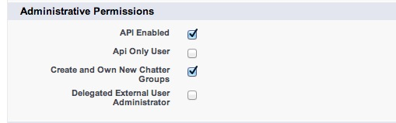
Delegated Administration
Only available to Partner Portal / Partner Communities / CPEA users
User needs to have the "Manage External User" permission set on their profile
Delegated Administration supports:
-Creating new contacts / users
-Assign any available profile to those users
Notes:
Swap the image with a communities, two slides, second with communities. Chatter: mobile, social, and business data. Social data—extend beyond 4 walls.
Customer companies are also connected with their partners, distributors, and suppliers so they can share customer information and better sell and service customers.
Customer companies even have connected products. By connecting your products to your employees, your customers, and social networks, you can better service your customers. You can use product data for maintenance, marketing promotions, and sales opportunities.
This is what a customer company looks like. You need to be more deeply integrated with your customers than ever before because that’s what they want, and it’s more possible and more exciting today than it ever was before.

Slide 12
Chatter / Anti-social Communities
All users can view their own profile
Other than that, you can make a community anti-social
To do so, you can do some or all of these:
Set External User Visibility in Sharing Settings
Remove the Chatter, Files, Groups, People tabs from the UI
Remove ability to create groups
Remove the Global Search bar form the UI
Remove all publisher actions from the global Chatter layouts
Remove all publisher actions from the object page layouts
Turn off Feed Tracking for the objects exposed in the community
* Only exception is that a user could potentially see Chatter posts on a record even if they can't see the user who posted
If you want to be completely sure users will not see Chatter, you should turn off feed tracking for that object.
Notes:
Swap the image with a communities, two slides, second with communities. Chatter: mobile, social, and business data. Social data—extend beyond 4 walls.
Customer companies are also connected with their partners, distributors, and suppliers so they can share customer information and better sell and service customers.
Customer companies even have connected products. By connecting your products to your employees, your customers, and social networks, you can better service your customers. You can use product data for maintenance, marketing promotions, and sales opportunities.
This is what a customer company looks like. You need to be more deeply integrated with your customers than ever before because that’s what they want, and it’s more possible and more exciting today than it ever was before.

